Slide 1



The Impact of Wildfire Activity on Stream Temperature in Colorado
Jonathon Hirschi
April 27, 2021
Data 2 Policy Symposium 2021
Math 5387, Dr. Joshua French

Slide 2
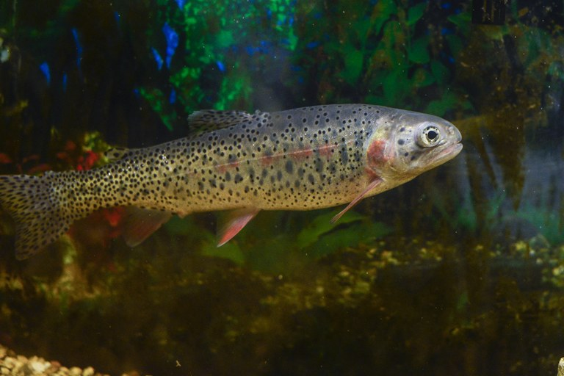
Stream Temperature Background
Stream water temperature is critically important to ecological systems
Microbes, insects, fish, and other aquatic species have adapted to specific temperature ranges
In Colorado, species like the threatened Greenback Cutthroat Trout depend on cold waters for spawning, ideally 2.7 – 12.8 ⁰C (37 - 55 ⁰F)

Slide 3
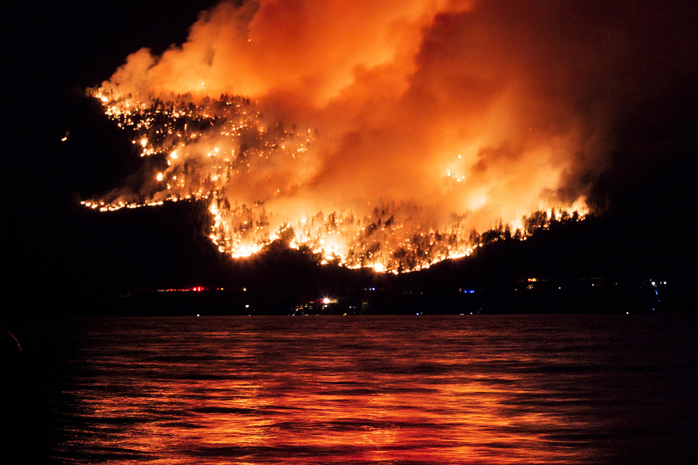
Wildfires and Stream Temperature
Wildfires can directly heat waters and destroy vegetation that provides cooling shade (riparian zones)
Climate change is projected to cause increased wildfire activity, so it is important to understand how this will affect water quality

Slide 4
Analysis Goal
Build a statistical model of stream temperature in Colorado
Examine the relationship between wildfire activity and stream temperature

Slide 5
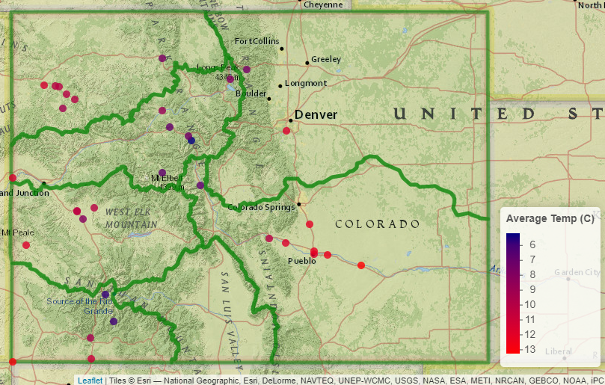
Water Quality Data - USGS
The United States Geological Survey (USGS) has water monitoring sites all over the country
USGS developed the R package dataRetrieval to allow researchers to easily access water quality data
We collected water temperature and discharge (flow rate) data in addition to physical information on the sites, such as elevation above sea level and major river basin
In total, we utilized data from 34 USGS monitoring sites
We averaged the data over season
USGS Sites Utilized, with Major River Basin

Slide 6
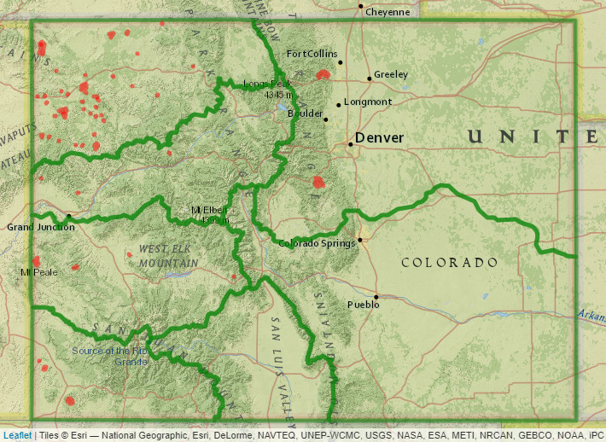
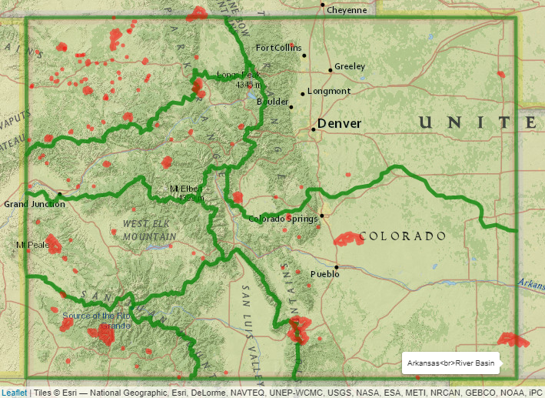
Wildfire Data – NIFC
The National Interagency Fire Center (NIFC) provides spatial data for the locations, dates, and sizes for wildfires in America from 2000-2018
Colorado had 953 wildfires over this period
We calculated the number of fires per season and total acres burned, averaged over the major river basin
Colorado Wildfires – 2000
Colorado Wildfires – 2018

Slide 7
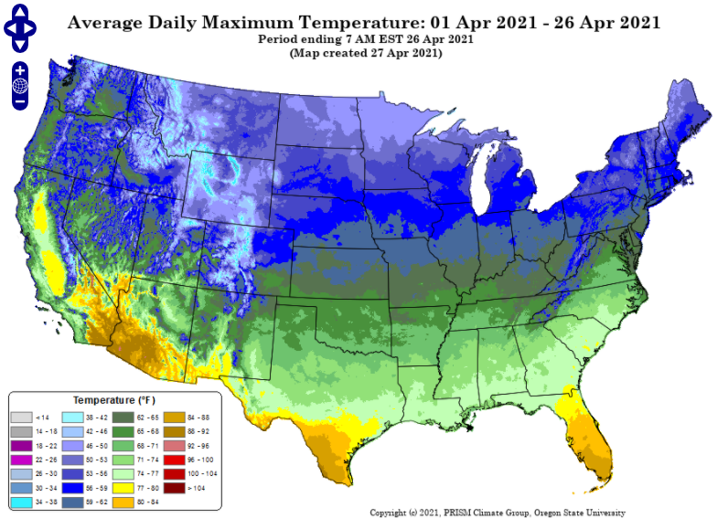
Climate Data – PRISM
The PRISM Climate Group provides detailed spatial climate data for short and long term
We accessed this data using the R package climateR, developed by Mike Johnson of NOAA
We extracted the daily maximum temperature and precipitation in millimeters at the locations of the USGS monitoring sites from 2000-2018

Slide 8
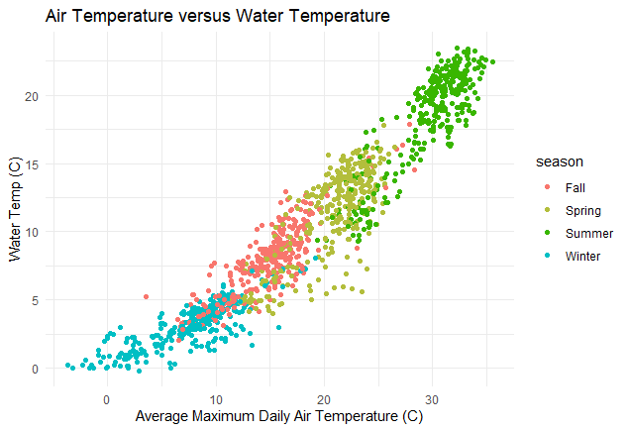
Data Exploration – Air Temperature
Air temperature is strongly related to stream water temperature
We examined a simple quadratic trend (temperature plus temperature squared)

Slide 9
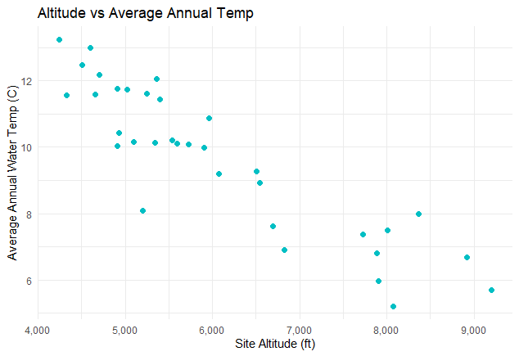
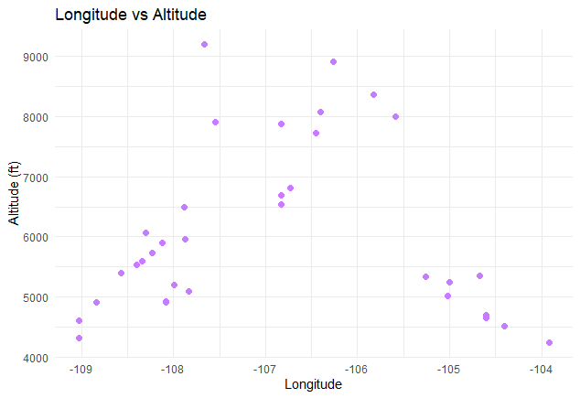
Data Exploration – Altitude
Water temperatures are colder at higher altitudes (feet above sea level)
In Colorado, altitude is strongly related to longitude due to the North-South orientation of the Rocky Mountains
Each plot point represents averages over USGS Site

Slide 10
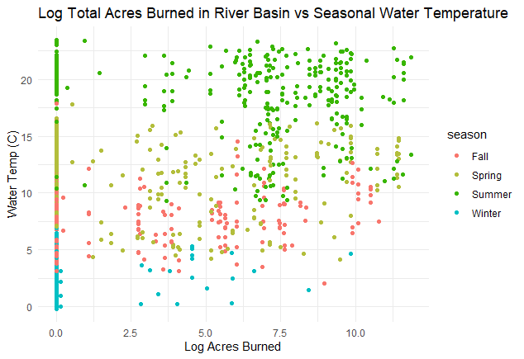
Data Exploration – Wildfires
The natural log of acres burned in a River Basin is slightly related to water temperature

Slide 11
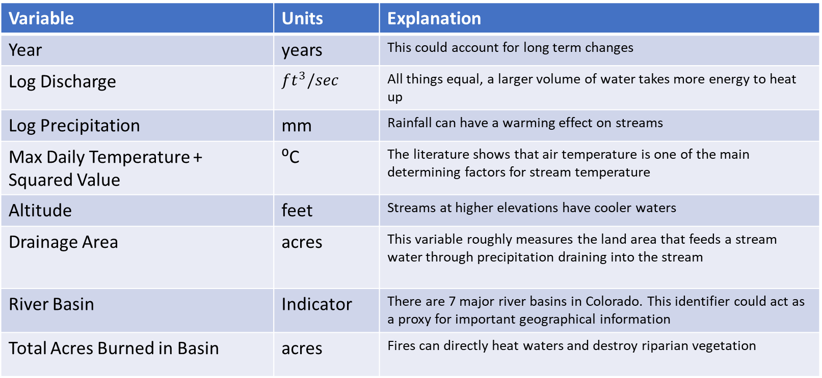
Variables Utilized in Model
After variable selection and diagnostic checks, we arrived at the following set of regressors
We are ignoring the effect of repeated observations from the sites (for now)
Variable | Units | Explanation
Year | years | This could account for long term changes
Log Discharge | $$ft^{3}/sec$$ | All things equal, a larger volume of water takes more energy to heat up
Log Precipitation | mm | Rainfall can have a warming effect on streams
Max Daily Temperature + Squared Value | ⁰C | The literature shows that air temperature is one of the main determining factors for stream temperature
Altitude | feet | Streams at higher elevations have cooler waters
Drainage Area | acres | This variable roughly measures the land area that feeds a stream water through precipitation draining into the stream
River Basin | Indicator | There are 7 major river basins in Colorado. This identifier could act as a proxy for important geographical information
Total Acres Burned in Basin | acres | Fires can directly heat waters and destroy riparian vegetation

Slide 12
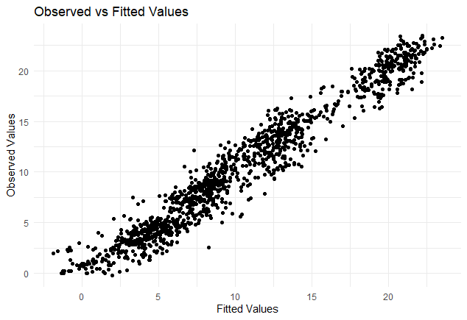

Model Fit
The model closely fit the data with no obvious structural deficiencies
The adjusted $R^{2}$ value was 0.947

Slide 13
Model Results
Variable | Direction and Relative Magnitude of Relationship | Statistical Significance
Year | Slightly negative | Not significant
Log Discharge | Negative | ***
Log Precipitation | Positive | ***
Max Daily Temperature + Squared Value | ⁰C | ***
Altitude | Negative | ***
Drainage Area | Slightly positive | ***
River Basin |  | Mixed, some basins were significantly different. Arkansas River basin had warmest waters, and San Juan River basin had coolest
Total Acres Burned in Basin | Positive | Not significant

Slide 14
Effect of Wildfire Findings
Total acres burned in the river basin had a slight positive relationship with water temperature, but the results were not statistically significant
In other words, the data was consistent with there being no relationship between acres burned by wildfire and stream temperature

Slide 15
Additional Thoughts
The treatment of wildfire data was broad, and merits further investigation
There are many other important variables that could be included in a full model of stream temperature
Researchers have developed accurate climate forecasting models, so stream temperature could be accurately forecasted into the future to see how climate change would affect ecosystems

Slide 16
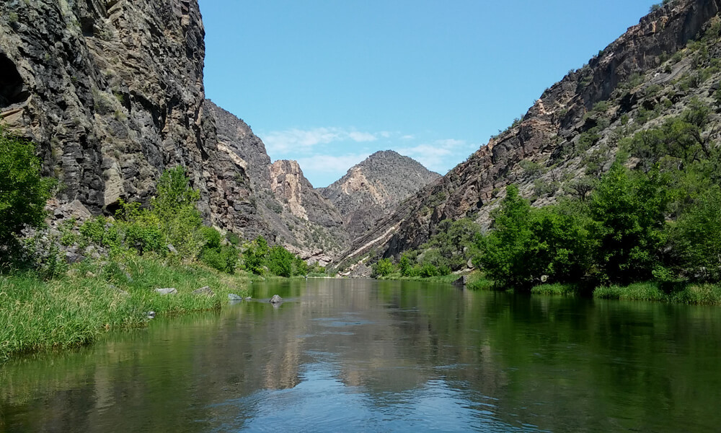
Policy Suggestions
Riparian zone restoration and management
Healthy riparian zones are high in moisture and can slow the spread of wildfires
This would have multiple benefits, such as habitat restoration, temperature regulation, and wildfire management
Consider effects of wildfires holistically
Climate change, wildfires, and water quality are all linked
This is also linked to things like fishing and drinking water quality
Gunnison River, Colorado

Slide 17
References
Stream temperature background, USGS:
https://www.usgs.gov/special-topic/water-science-school/science/temperature-and-water?qt-science_center_objects=0#qt-science_center_objects
Fish Habitat Background, NRCS:
https://efotg.sc.egov.usda.gov/references/public/CO/coldwaterfish.pdf
USGS dataRetrieval R Package:
https://cran.r-project.org/web/packages/dataRetrieval/vignettes/dataRetrieval.html
Wildfire and Riparian Zones, USFS:
https://www.fs.fed.us/psw/topics/fire_science/ecosystems/riparian.shtml

